Slide 1
MARINEi
Prof. Lars Johanning
University of Exeter
Marine-i Lead Partner

Slide 2
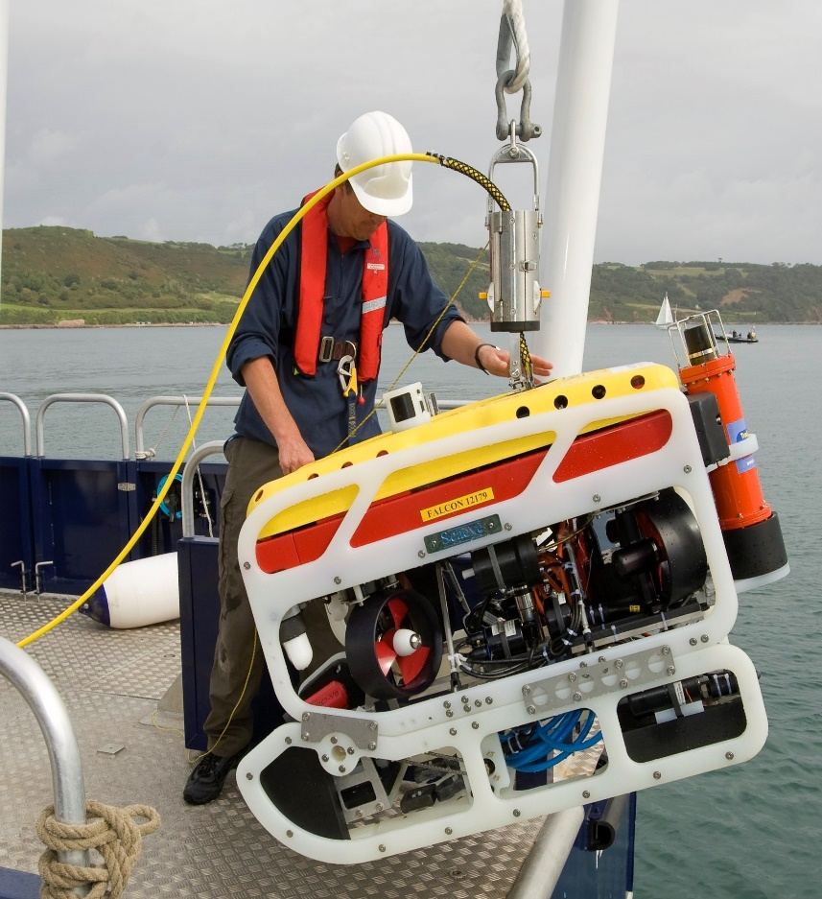
Marine-i enters a new phase
Vision: Marine-i provides leadership and a focal point to galvanise and support business-led and market-driven Research, Development and Innovation.
The new programme is focussed on accelerating development of innovative product ideas, working closely with businesses to the stage at which their products can be demonstrated and can be commercialised.
Builds on the success of the initial Marine-i phase 1, which ran between 2017 – end of 2019. The new programme runs until the end of 2022, takes Marine-i to the next level, and has a fresh emphasis.
Partnership - University of Exeter, University of Plymouth, Offshore Renewable Energy Catapult, The Cornwall College Group, Cornwall Marine Network, and Cornwall Development Company.
Total Funding: £5,519, 710. ERDF: £4,146,161. Public Match: £596,639

Slide 3
What stays the same as the first Marine-i programme?
Our Aim – to create a sustainable and innovative marine technology sector in Cornwall, where businesses can thrive and succeed in global markets well into the future
Our Mission – “Marine-I should be mindful of the challenge posed by Climate Change, the need to transition to a Low Carbon Economy and the need to manage Changing Coastal Processes. The Marine-I programme should prioritise RD&I leading to Marine Technology Processes, Products and Services with the potential to have a significant impact in the Low Carbon Energy markets and other growth areas within the Ocean Economy, notably those associated with new technology addressing the Clean Marine agenda and Coastal Adaptation.” MI2 Strategic Partner Board
Our Alignment – we remain aligned with key regional, national and global strategies relating to the marine technology industry

Slide 4
The offer to businesses
Comprehensive RD&I support through engagement with world class research expertise – This accelerates the stage at which you can demonstrate your product and take it to market. We will listen to your ideas and then work closely with you to develop them – enabling the best support from our team.
Access to an exceptional range of test facilities. Including flagship test facilities for ocean engineering based at University of Exeter, University of Plymouth and Offshore Renewable Energy Catapult
Graduate placements to work in your business at a subsidised cost, for a period of 3,6 or 9 months.
Outreach programme. Marine-i regular events bring together thought leaders from industry and research experts to discuss market challenges and potential solutions, and access to national supply chain improvement initiatives.
Increased profile for your business. Marine-i case studies have featured in marine technology media around the world. You too can benefit from profile raising through taking part in Marine-i.
Grant support. Grant funding support is available through Marine-i for selected projects.

Slide 5
Key areas
- Marine and offshore energy
- Marine technology
- Aquaculture technology
- Novel Mooring systems / component development
- Marine operations and maintenance strategies
- Autonomous marine systems
- Applied optimization
- Optimization of Floating Platform design
- Health/condition monitoring
Key Subsectors
- Energy efficiency and generation
- Wind/Wave/Current loading
- Mooring design and analysis
- Reliability and statistical methods
- Material and mechanical behaviour.
- AI and Data Science
Key Skills
- Analytical/computational modelling and analysis
- Experimental modelling and analysis
- Hydrodynamic experimentation
- Mechanical experimentation (performance characterisation, reliability and fatigue)
- Marine data measurement and analysis
- Environmental/Marine resource characterisation
- Optimization
- Machine learning & artificial intelligence
Software Capabilities
- Ansys - SWAN
- MATLAB - Python
- Nemoh - SolidWorks
- OpenFOAM
- Orcaflex WAMIT

Slide 6
Examples of Marine-i test facilities

Slide 7
Examples of Marine-i test facilities

Slide 8
Examples of Marine-i test facilities

Slide 9
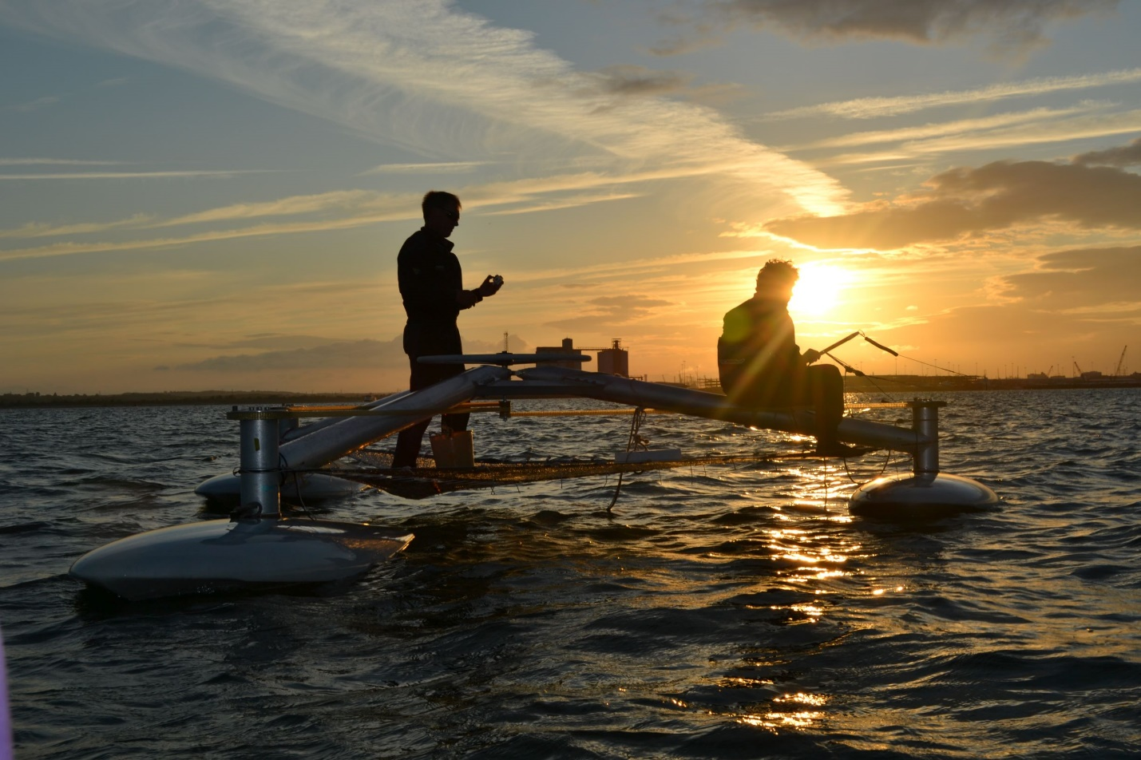
Accelerating business growth
The world class RD&I expertise and the outstanding test facilities available through Marine-i have already enabled:
Many exciting new product developments
and
Opening global market opportunities for Cornish businesses.
We now aim to build further on this success and help more businesses accelerate their growth.

Slide 10
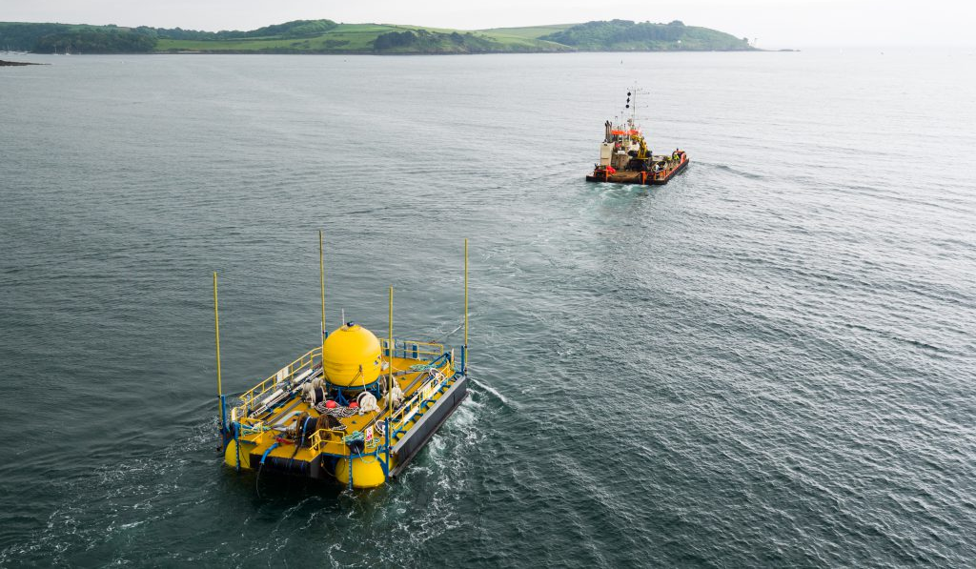
We aim to continue our success with Marine-i
“The whole experience of working with Marine-i has been extremely positive. It is proving to be a valuable catalyst in helping us along our journey towards commercialisation.”
- Tom Birbeck, ARC Marine
“The success that we have achieved with these trials at COASTLab and FaBTest has enabled us to take a significant step towards commercialisation of our new technologies.”
– Craig Whitlam, Marine Power Systems

Slide 11
Thank You
www.marine-i.co.uk

